Slide 1
Software testing

Slide 2
Computer system failures caused by software bugs
  The stock of a major health industry company dropped 60% due to reports of failures in computer billing systems, problems with a large database conversion, and inadequate software testing. It was reported that more than $100,000,000 in receivables had to be written off and that multi-million dollar fines were levied on the company by government agencies

Slide 3
Computer system failures caused by software bugs
  On June 4 1996 the first flight of the European Space Agency's new Ariane 5 rocket failed shortly after launching, resulting in an estimated uninsured loss of a half billion dollars. It was reportedly due to the lack of exception handling of a floating-point error in a conversion from a 64-bit integer to a 16-bit signed integer.

Slide 4
Computer system failures caused by software bugs
  Software bugs in a Soviet early-warning monitoring system nearly brought on nuclear war in 1983, according to news reports in early 1999. The software was supposed to filter out false missile detections caused by Soviet satellites picking up sunlight reflections off cloud-tops, but failed to do so. Disaster was averted when a Soviet commander, based on a what he said was a '...funny feeling in my gut', decided the apparent missile attack was a false alarm. The filtering software code was rewritten.

Slide 5
Computer system failures caused by software bugs
  In April of 1999 a software bug caused the failure of a $1.2 billion military satellite launch, the costliest unmanned accident in the history of Cape Canaveral launches. The failure was the latest in a string of launch failures, triggering a complete military and industry review of U.S. space launch programs, including software integration and testing processes. Congressional oversight hearings were requested

Slide 6
Software Testing
Software testing
It is exhilarating. It is exasperating
It can be the best of jobs – or the worst
It is fundamental to delivering quality software on time within budget

Slide 7
Methodology Questions
What are the key testing methods, when do we use them, and how do we implement them?
How do we prevent defect to migration and improve defect finding capabilities
How can we understand and leverage the relevant test standards and terminology
How do we create meaningful test plans and other critical test deliverables?
How do we identify and prioritize potential software testing process improvements?

Slide 8
Leadership questions
How do we organize the software testing effort so it is measurable and controllable?
Where can we find additional help regarding software testing?
How can we organize testing for the most effective relations between people?
How can we generally maximize exhilaration and minimize exasperation?

Slide 9
Tools and Technology questions
What are the most significant opportunities for automating the testing process?
How can we use measurement to understand and control the software test process?
How can we select test tools and vendors and implement an effective tools program?
How can we use risk analysis techniques as a basis for decision making in testing?

Slide 10
“The quality of a software system is governed by the quality of the process used to develop and evolve it”e: Watts S Humphrey
Quote: Watts S Humphrey

Slide 11
Testing Process
The software testing process is means by which People, Methods, Measurement Tools, and equipment are integrated to test a software product.

Slide 12
Essentials of software testing
1. The quality of the test process determines the success of the test effort.
- Testing process starts with requirement phase.
- Immature development process will have more pain than those that don’t

Slide 13
Essentials of software testing
2. Prevent defect migration by using early life-cycle testing techniques.
- Effective test program prevents the migration of errors
- Chaos zone

Slide 14
Essentials of software testing
3. The time for software testing tool is now
- It is important to have strategy for tool acquisition and proper procedure for toll selection.

Slide 15
Essentials of software testing
4. A real person must take responsibility for improving the testing process
- Management support
- people to take responsibilities for improvement

Slide 16
Essentials of software testing
5. Testing is a professional discipline requiring trained, skilled people.
- profession, a career choice
- done properly it surpasses the challenge of product development
- independent, unbiased, organized teams

Slide 17
Essentials of software testing
6. Cultivate a positive team attitude of creative destruction
- testing requires disciplined creativity
- requires a focus on basic factors like planning, project & process control, risk management, inspections, measurements, tools, organization & professionalism

Slide 18
Testers mission
Basic professional attitude, can have a profound effect on
the success of the testing effort and can provide a catalyst
for improvement throughout the development process

Slide 19
Good testers
Have testing attitude
Hunt for errors
Are destructive- but creatively so
Pursue errors not people
Add value

Slide 20
Personal Software Process
Plan the activities
Track the work
Post-mortem
Continuous improvement of process and productivity.

Slide 21
Software Development Life Cycle

Slide 22




Software Development Life Cycle
How the customers explained it
How the Project Leader understood it
How the Analyst designed it
How the Programmer wrote it

Slide 23



Software Development Life Cycle
How the Business Consultant described it
How the project was documented
What operations installed

Slide 24
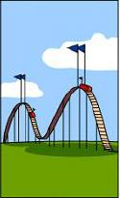


Software Development Life Cycle
How the customer was billed
How it was supported
What the customer really needed

Slide 25
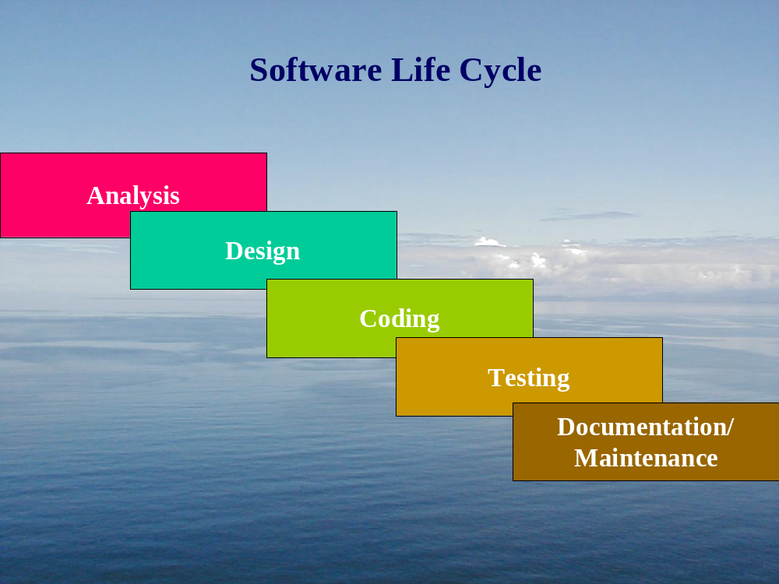
Software Life Cycle

Slide 26
Software Development Life Cycle
Specifications
Design
Implementation
Testing
Maintenance

Slide 27
The Process of Software Requirements Engineering
Software Requirements Engineering
Problem definition
Validated SRS Documents

Slide 28
Tasks in requirements engineering stage
Requirements
analysis
Requirements
Specifications
Requirements
Validation
Problem
Definition
Validated
SRS
Document

Slide 29
Non-functional requirements
Non-functional requirements
Product
requirements
Process
requirements
External
requirements
Reliability
Portability
Usability
Efficiency
Delivery
time
Implementation
requirements
(h/w & s/w
requirements
Standards
Performance
Space
safety
Privacy/
security
Inter-
operability
Ethical
Legal
Response Time
Throughput
Components of Software Requirement Specifications

Slide 30
Design process
Design
Software Requirements Specifications
Validated Design Documents

Slide 31
Stages in Design Process
System design
or
Top level design
Detailed design
or
Logic design
Design
or
validation
Validated
SRS
Document
Validated
Design
Document

Slide 32
The Implementation process
Implementation
Validated design document
Source Code

Slide 33
The Testing Process
Test inputs
Source code
Executable
code
Test Output
Testing
Defect analysis

Slide 34
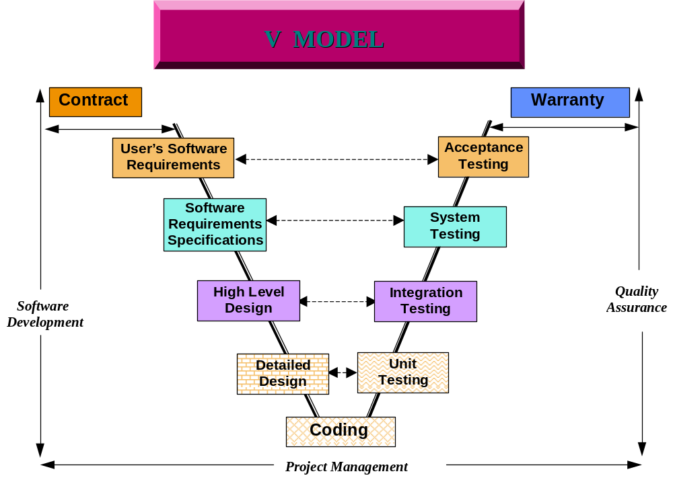
Relation of Development and Testing Phases

Slide 35
Structured Software Testing Method

Slide 36
Module 1
INTRODUCTION

Slide 37
Testing Myths
Testing is Nothing but debugging
Testing is done to prove that
The software ‘Works’
The Software does not ‘Work”
Testing is not the job of a Programmer
If programmers were more careful testing would be
unnecessary

Slide 38
Testing Myths
Testing never ends
Testing activities start only after the coding is complete
Testing is not a creative task
Testing gets in the way

Slide 39
Reality
Time Pressures
Slipped delivery dates
immovable shipping dates
Untested Code delivery
bits & pieces
Resource Shortages
Creeping Requirements

Slide 40
Reality
Do more (and more..)
Field fix testing
Review new feature development
Write Test plans & Test specifications
Conduct Project Retrospectives
Automate as you go
Lack of Experienced hands
“any-body” will do syndrome

Slide 41
Reality
Lack of dedicated software test environment
Share,Steal
Use production facilities(cross your fingers!)
Be the expert consultant
SE,DEV,Customers
You name it

Slide 42
Reality
And the Test book says
Allow sufficient time
Estimate with margin for error
Plan,monitor,control,implement
Evaluate alternate test strategies
Automation is key
Have trained tests as back-up

Slide 43
Aspects that Hinder Effective Testing
Optimism
Belief that the system works
Ego
Negative attitude towards effective testing
Conflict between testers and developers
Delivery Commitments
Don’t want to fail

Slide 44
Aspects that Hinder Effective Testing
Testing is least structures
Testing is expensive
  Tools
  Resources
  Maintenance of Repositories
  Repeated nature of testing

Slide 45
Reality
And now to make both ends meet
Seeking to be understood that..
Testing is not magic
Cannot accomplish as planned when upstream intervals
slip & downstream dates don’t change
Testers do not live on other planets
laws of project management do not work differently
(daily tracking of test execution does not make up for
lost time in slipped / shortened intervals)

Slide 46
Reality
Testing is not a free bee
it does cost $$$ to have isolated test environments that
simulate user conditions in which product quality can
be evaluated and improved
Time warp does not exist for tester either
the same testers cannot work on testing current projects, and
test fixes on previous releases of projects, and also review
future release documents – preferably at the same time

Slide 47
Testing
Testing is the process of exercising or evaluating
a systems or system component by manual or
automated means to verify that it satisfies specifies
requirements –(IEEE83a)
Process:
Sequence of steps performed for a given purpose.(IEEE)
Software Process
A set of activities, methods, practices, and transformations
that people use to develop and maintain software and
associated products.(SEI-CMM)

Slide 48
Role of Testing
Primary
Determine whether system meets specifications
Determine whether system meets needs
Secondary
Instill confidence
Provide insight into the software development process
Continuously improve the testing process

Slide 49
What Testing Shows
errors
Requirements conformance
performance
An indication of quality

Slide 50
Some English..
Verification
Methods to ensure that the system complies with an
organization standard or process
Did we build the right system?
Validation
Ensure that the system operates according to a plan by
executing system function
Did we build the system right?
So what do we need to do most when we test?

Slide 51
Testing Jargon
Types
Functional Testing
Structural Testing
White box Testing
Black Box Testing
Methods
Dynamic Testing
Static Testing
Levels of Testing
Units
Integration
System
User Acceptance

Slide 52
Testing Terminology
Architecture of process
Test Strategy
Test Plan
Testing Phase
Test Factor
Test Method
Testing Techniques
Architecture of work products
Test Case
Test Data
Test Script
Test Bed

Slide 53
How is your testing?
Drivers
Tools
Quality Control
Use of Process
Efficiency
Management Support
User Satisfaction
Planning
Training
Results
How good are they ?

Slide 54
Module 2
Taxonomy of Bugs

Slide 55
“Bugs”
Form Welsh “bwg”;not an “effete Norman word”
such as fault
Documented in the sense of “goblin” 1388
In the sense of insect only in 1642
In the sense of “defect of fault in a machine, plan,
or the like” 1889(Edison)

Slide 56
“Bugs”
The story about(Radm) Grace Hopper finding an insect
in the hardware may to true, but is not the genesis of
the term “bug” in programming
To debug in the sense “to remove faults form” is traced
back to 1945

Slide 57
“Importance” of bugs(in$$)
Frequency(Fre)
Correction Cost(Cor)
Typically, Significantly more the later the bug is discovered
Installation Cost(Ins)
Cost of installing the fix
Consequences(Con)
Legal awards

Slide 58
“Importance” of bugs(in$$)
Consequences(Con)
Legal awards
Importance=Fre*(Cor+Ins+Con)
It’s not obvious that these costs can simply be added
Another cost item may be “bug maintenance” : help desk effort, etc.
to assist user to work around it

Slide 59
Not all bugs are equals
infections
catastrophic
extreme
damage
serious
disturbing
annoying
mild
Bug Type

Slide 60
Consequences
Mild
Aesthetics.Typos
Moderate
Redundant outputs. Performance effect
Annoying
$0.00 bills sent. Byzantine command sequences required
Disturbing
ATM does not dispense money. My account is canceled
Serious
Paycheck disappears. Payments are lost track of

Slide 61
Consequences
Very Serious
Some deposits turn into withdrawals
Extreme
The problems happen frequently to many users
Intolerable
Irrecoverable database corruption
Catastrophic
The system crashes permanently
Infectious
“A system that kills” by starting a war or causing
a reactor melt-down

Slide 62
Perceives bug severity
Context:
A round off error , critical in space but trivial in a computer game
Creating Culture
Test tool vendors sensitive to bugs; educational software makes
sensitive to typos and grammar
Some bugs may be declared features
User Culture
An R&D shop may live with something that’s illegal in accounting
Development phase:
Minor bug ignored early on
“Don’t fix bug later; fix them now”

Slide 63
Bug taxonomy
“Taxonomy”: Systematic classification
Requirements and feature bugs
Structural bugs
Data bugs
“Coding” bugs
Interface, integration and system bugs
Test and test design bugs

Slide 64
Detailed Taxonomy
Requirements & Feature Bugs
Requirements bugs are the first to invade the system and
the last to leave
Space are often self-contradictory , incomplete and ambiguous
Extra features, other gratuitous enhancements tend to be error phone
Feature interaction problems
Structural Bugs
Control and sequence bugs
Logic bugs
Processing bugs
Initialization and dataflow bugs

Slide 65
Detailed Taxonomy
Structural Bugs
Unreachable code
Paths left out
Go to problems
Spaghetti code
Pachinko code[historic note]: Self-modifying code, really only
possible in assembler

Slide 66
Detailed Taxonomy
Logic Bugs
Misunderstood switch-statement semantic
Improper Boolean logic
Improper simplification and combination of cases
Misunderstood expression evaluation

Slide 67
Detailed Taxonomy
Processing Bugs
Arithmetic bugs
Algebraic bugs
Incorrect conversion
Initialization and data bugs
Improper initialization
Using an un-initialized variable
Double initialization
Modifying data but not keeping the result
Dangling pointers

Slide 68
Detailed Taxonomy
Coding Bugs
Typos
Misunderstood language syntax and semantics
Erroneous comments
Interface,integration & System Bugs
External interfaces
Internal interface
Bugs related to hardware, system software or OS interface
Integration bugs:
Tests & Test Design Bugs
Bugs in the test(“Scaffolding”) Software
Bugs in test date

Slide 69
Module 3
Test Process

Slide 70
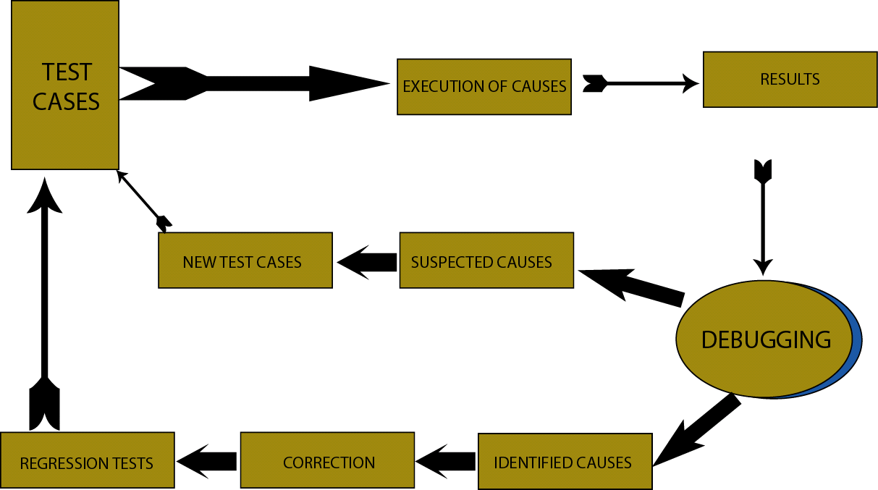
Process Setup

Slide 71
Test Methodology
Specifications
Clues
Expected behavior
Test requirements
Program Output
Is correct
Test specifications
Oracle
OR
Test driver
Program has failed
Make a note and
Proceed With testing
or get into the debug
mode
Until specs
Exhausted
Actual Behavior
Program

Slide 72
Test Factors
Correctness
Authorization
File Integrity
Audit Trial
Continuity of Processing
Service Levels
Access Control
Compliance
Reliability
Ease of Use
Maintainable
Portable
Coupling
Performance
Ease of operations

Slide 73
Testing Issues-Test Organization
System
Functional
Requirement
Other
Software
Requirement
Customer
Requirement
Specifications
User
Environment
Unit
Test
Design
Specification
Tested Components
Integration
Test
Function
Test
Performance
Test
Acceptance
Test
Installation
Test
Unit
Test
Tested Components
Unit
Test
Integrated
Modules
Functioning
System
Verified
Validated
Software
Accepted
System

Slide 74
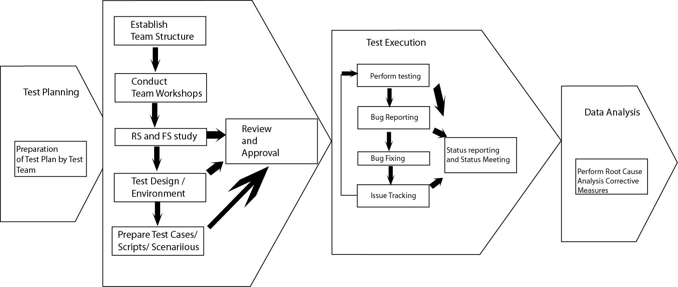
The Test Process()

Slide 75
Effective Test Process
Components
Ensuring Software testability
Ensuring testing form beginning
Preventive measures by verification/validation
Test Audit
Post-release activities

Slide 76
Effective Test Process
Characteristics
Risk driven planning
Test case/script design against specification
Metric driven test execution
Managing test like a code
Support processes like
test database,
Centralized defect tracking tools, and
Version control of test cases/system
Quantifiable test completion criteria

Slide 77
Test Planning
Helps design and organize the test
To ensure that the test in appropriate and through
Steps :
establish test objectives
designing test cases
writing test cases
testing test cases
executing test cases
evaluating test results

Slide 78
Objectives of Test Planning
Obtain commitment form affected groups
Brings in Effective collaboration among the teams
Specify deliverables
Formally planned testing brings out carefully thought
through test cases
Enables effective tracking & decision making
Define the Responsibilities
Decide on Automation Early
Decide on Test Metrics & Manage through Metrics
“When to stop Testing?”

Slide 79
Input for Test Planning
Requirements
Analyze the product
Functional & Design Specifications
Understand the Features
Project Plan
Estimation & Schedule
Previous Records
Compare Estimates & Plan

Slide 80
Requirement Specification
What to analyze ?
User (Who they are and what they do)
Operations(What it’s used for)
Testable nature of the Product
Do we have the Domain Expertise?
Infrastructure?
Why to Analyze
Perform product/prototype walkthrough.
Review Requirements Specification.
Interview Requirements Study Team and users.
Compare with similar products

Slide 81
Requirement Specification
Outputs
Requirements As Understood by Testers
Describe in Testers own words
Product Annotations
Product Issue list – related to Testing
Understandings
Can you visualize the product and predict behavior ?
Can you configure and operate the product ?
Do you understand how the product will be used ?
Do you find any gaps in “Requirements ?
Do you have remaining questions regarding the product ?

Slide 82
Functional & Design Specification
What to Analyze
Product Features
Product Structure ( Code, file, etc.)
Product Functions (what it does)
Product Data ( input, output, state, etc.)
Platforms (external hardware and software)
Way to Analyze
Review FS & Design
Discuss with Functional Consultants & Designers
Separate functions & features

Slide 83
Functional & Design Specification
Outputs
Product Coverage Outline
Basic for Test Design
List of non-testable features with reasons
Understandings
Do designers approve of the product coverage outline ?
Do designers think you understand the products ?
Are you aware of gaps or inconsistencies in the design ?
Will you be able to produce test data (input and results) ?

Slide 84
Project Plan
Project Estimates
Product Size ( Component / Module Wise)
Development Effort
Project Gantt Chart
Development Milestones
Module Completion Dates
Unit Test Schedules
Project Plan Document
Scope of the Project
Project Deliverables
Project Risks
project Status Reporting

Slide 85
Test Estimation & Scheduling
Test estimation should be based on
Quantifiable Requirements
Scope of testing
Coding Vs. Unit Testing Efforts
Nature bugs during previous release or project
Contractual agreements
What % development Effort ?
Organizational Norms
Previous Experiences
Productivity of Testers

Slide 86
Test Estimation & Scheduling
Scientific Techniques
Test Case Points
Test Point Analysis
Use Case Points
Function Points

Slide 87
Test Planning
Purpose of the Plan
to organize testing activities
Test Plan
describe the way in which we will show our customers that
the software works correctly
It not only address unit and integration testing, but the other
testing phases as well
explains who does testing, why perform tests, how tests are
conducted, when is it scheduled
must know the requirements, functional spaces,
modular hierarchy

Slide 88
Contents of a Test Plan
Test objectives
addressing each type of testing form unit thru functional
Looks ate
how test will be run and
what criteria will be used to determine when the testing
is complete
Decides how to integrate components
For each of the testing, describe the method to the used
to perform each test

Slide 89
Test Plan Heuristics
Focus most effort on areas of potential technical risk
Complete testing is impossible
Test plan should address
test platform configuration
how the product will be operated
how the product will be observed , and
how observations will be used to evaluate the product.
Test plan should be diversified in terms of test technique
and perspectives

Slide 90
Test Plan Heuristics
No single test technique can reveal all – important
problems in a linear fashion
The test plan should specify
How test data would be designed and generated
It is important to test against implied requirements
The test project should promote collaboration with all
Other functions of the project, especially developers

Slide 91
Test Plan Heuristics
The test project should consults with development
to help them build a more testable product
A test plan should highlight the non-routine,
project-specific aspects of the test strategy and
test project

Slide 92
Test Deliverables
Test Scripts / Cases / Scenario
Post Test Validation Form
Test Summary Report
Benchmarking Report
Records on Test process
Free zed configuration items in Configuration
Management Tool
Problem reports indicating list of open bugs
Release Sign-off
Test Metrics
Test library for future use

Slide 93
Test Documentation
Difficult to coordinate testing with large number of people
Used to control the complexity and difficulty of testing
(Using a carefully designed test documentation)

Slide 94
Type of Documents
Test Plan- describes the system itself and the plan for
exercising all functions and characteristics
guide the management of testing
guide the technical effort required during testing
establish test planning and scheduling, including specifying
equipment needed, organizational requirements, test methods,
anticipated outcomes, and user orientation
explain the nature and extent of each test
explain how the tests will completely evaluate system function
and performance
document test input specific test procedures,
and expected outcomes

Slide 95
Type of Documents
Test Specification and evaluation
Details each test and defines the criteria for evaluating each
feature addressed by the test
Test Description
Presents the test data and procedures for individual tests
Test Analysis Report
Describes the results of each test

Slide 96
Module 4
Test Case Design Techniques

Slide 97
Testing principles
All test should be traceable to customer requirements
Test should be planned long before testing begins
Testing should begin in the small and progress toward
testing in the large
Exhaustive testing in not possible
To be more effective, testing should be conducted by an
independent third party

Slide 98
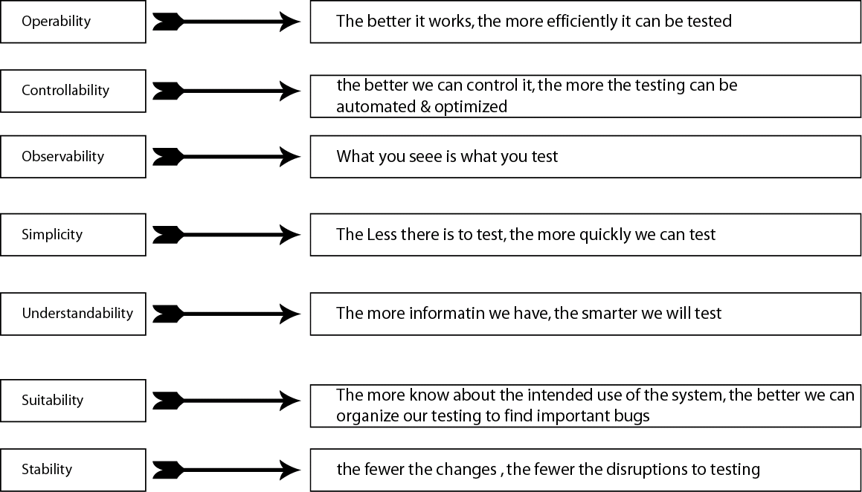
Software Testability

Slide 99
Test Case Design
White Box Testing
Also know as glass box testing
Is a test case design that uses the control structure of the
procedural design to derive test cases
It guarantees that all independent paths within a module have
been exercised at least once
Exercise all logical decisions on their true an false sides
Execute all loops their boundaries and within their operational
bounds
Exercise internal data structures to assure their validity

Slide 100
Test Case Design-White Box
Basic Path Testing
Is a white box testing technique
It enables test case designers to derive a logical complexity
measure of a procedural design
Using this as a guide for defining a basis set of execution path
Test cases derived to exercise the basis set are guaranteed to
execute statement in the program at least one time during
testing

Slide 101
Test Case Design-White Box
Cyclomatic Complexity
Is a software metric that provides a quantitative measure of the
logical complexity of a program
when used with basis path, it defines the number of independent
paths in the basis set of a program
Provides with an upper bound for the number of tests that must
be conducted to ensure that all statements have been executed
at least once

Slide 102
White Box Testing – Basis Path
Cyclomatic Complexity
How many path are we looking for ?
The number of regions of the flow graph correspond to cyclomatic
complexity
Cyclomatic Complexity, V(G), for a flow graph G is defined as
V(G)=E - N+ 2
Where E is the number of flow graph edges and N is the
number of flow graph nodes
Cyclomatic Complexity, V(G) , For a flow graph G is also defined as
V(G)=P+1, where P is the number of predicate nodes contained
in the flow graph G

Slide 103
White Box Testing – Basis Path
Deriving Test Cases
Using the design or code as a foundation, draw a corresponding flow
graph.
Determine the Cyclomatic complexity of the resultant flow graph
Determine a basis set of linearly independent paths
Prepare test cases that will force execution of each path in the basis
set

Slide 104
White Box Testing – Control structure Testing
Statement Coverage
100% statement coverage means that data will ensure that every statement
is executed at least once during testing
Also Called C1 or P1
Branch Coverage
100% branch coverage means that test data will ensure that every branch
executed at least once during testing.
Branch coverage includes statements coverage
Also called C2 or p2

Slide 105
White Box Testing – Control structure Testing
Multiple condition Coverage
100% multiple condition coverage means that data will ensure that every
Combination of unitary condition (in Compound conditions) is executed at
least once during testing
As a bare minimum, condition coverage is required
Path Coverage
100% path coverage means that test data will ensure that every path is
executed at least once during testing.
Path Coverage is also called P or C
8
8

Slide 106
White Box Testing – Control structure Testing
Condition Testing
A test case design method that exercises the logical condition contained in
a program module
Focuses on testing each condition in the program
Measurement of test coverage of a condition is simple
The test coverage of conditions in a program provides guidance for the
generation of additional test for the program
Relational Operator Testing
Requires three or four test to be derived for a relational expression
E1 { relational – operator } E2
E1 >, =, < E2

Slide 107
White Box Testing – Control structure Testing
Types of Errors
Boolean Operator Error
Boolean Variable Error
Boolean Parenthesis Error
Relational Operator Error
Arithmetic Expression Error

Slide 108
White Box Testing – Control structure Testing
Data Flow Testing
Select test path of a program according to the locations of definitions and uses of variables in the program
DEF(S)={x|Statement S contains a definition of x}
USE(S)={x|Statement S contains a use of x}
The definition of X in statement S is live at statement S1 if there
exists a path form statement S to statement S1 that does not contain any other definition of X
The definition use chain or DU chain of variable X is of the form [X,S,S1] where S and S1 are statement number , X is in DEF(S) and USE(S1), and the definition of X in statement S is live at Statement S1

Slide 109
White Box Testing – Control structure Testing
Loop Testing
Simple Loops
Skip the loop entirely
Only one pass through the loop
Two passes through the loop
m passes through the loop where m<n
n-1,n+1 passes through the loop

Slide 110
White Box Testing – Control structure Testing
Loop Testing – Nested Loops
Start at the innermost loop. Set all other loops to minimum values
Conduct simple loop test for the innermost loop while holding the outer loops at their minimum iteration parameter values. Add other tests for out-of-range or excluded values
work outward, conducting tests for the next loop , but keeping all other outer loops at minimum values and other nested loops to typical values
Continue until all loops have been tested.

Slide 111
White Box Testing – Control structure Testing
Concatenated Loops
Can be tested using approach defined for simple loops
Unstructured Loops
Whenever possible, this class of loops should be redesigned

Slide 112
Test Case Design
Black Box Testing
Focuses on functional requirement of the software
Derive sets of input conditions that will fully exercise all functional requirements for a program.
Not and alternative to white box

Slide 113
Test Case Design
Black Box Testing
Incorrect or mission function
Interface errors
Errors in data structures or external db access
Performance errors
Initialization and termination errors
Applied during the later stages of testing

Slide 114
Test Case Design – Black Box
Black Box Testing
How is functional validity tested ?
What classes of input will make good test cases ?
Is the system particularly sensitive to certain input values ?
How are the boundaries of a data class isolated ?
What data rates and data Volume can the system tolerate?
What effect will specific combinations of data have on system operation ?

Slide 115
Black Box Testing
Equivalence Partitioning
Black box testing that divides the input domain of a program
into classes of data
Strives to define a test case that uncovers classes of errors ,
reducing total number of test cases to e developed.
Based on classes of an input condition
Equivalence class represents a set of valid or invalid states for
input conditions
Con be numeric, range, set of related values, Boolean Values

Slide 116
Black Box Testing
Guidelines :
If an input condition specifies a range, one valid and two invalid
equivalence classes are defined
If an input condition requires a specific value, one valid and two
invalid equivalence classes are defined.
If an input condition specifies a member of a set, one valid and
one invalid equivalence class are defined.
if an input condition is Boolean , one valid and one invalid class
are defined

Slide 117
Black Box Testing
Boundary Value Analysis
Errors tend to occur at the boundaries of the input domain
than in the center.
Test case design that complements equivalence partitioning
Focuses on edges rather than input conditions

Slide 118
Black Box Testing
Guidelines
If an input condition specifies a rang bounded by values a and
b, test cases should be designed with values a and b, just above
and just bellow a and b respectively
if and input condition specifies a number of values, test cases
should be developed that exercise the minimum and maximum
numbers. Values just above and bellow minimum and maximum
are also tested.

Slide 119
Black Box Testing
Guidelines
Guideline 1 and 2 are applied to output conditions. Test cases
should be designed to create an output report the produces the
max and min allowable number of entries
If internal program data structures have prescribed boundaries
be certain to design a test case to exercise the data structure at
its boundary

Slide 120
Cause and Effect Graphs
Testing Would be a lot easier :
If we could automatically generate test cases form
requirements
Examine the requirements :
Restate them as logical relation between inputs and outputs
The result is a Boolean graph representing the relationships
called a cause – effect graph

Slide 121
Cause and Effect Graphs
Mark and number all causes and effects
Numbered causes and effects become nodes of the graph
Draw Causes on the LHS
Draw effects on the RHS
Draw logical relationship between causes and effects as
Edges in the graph.
Extra nodes can be added to simplify the graph
Convert the graph to a decision table :
Each column of the decision table corresponds to a test case
for functional testing

Slide 122
Drawing Causes – Effect Graphs
.
.
A
B
A
.
If A then B
B
C
A
B
If(not (A or B )) then C
C
A
B
If (A and B ) then C
C
A
B
If (not(A or B )) then C
C
A
B
If (A or B ) then C
If(not A) then B

Slide 123
Module 5
Testing Approaches

Slide 124
Unit Testing
Verifies that the component/ module functions properly
Done in a controlled environment
Test team feeds predetermined set of data to the component
And observe output
Checks the
Internal data Structures
Logic, and
Boundary conditions for the input and output data

Slide 125
Unit Testing
Normally white box oriented
Can be conducted in parallel
Examining the code by using code reviews such as
inspection and walkthrough
Data structure in examined
All independent paths are exercised

Slide 126
Unit Testing
Error handling path are tested
Use of stubs(modules to be called) and drivers
(modules that calls)

Slide 127
Integration Testing
Combining the individual components
Problems may occur due to :
Data lost across interface
One module can have an adverse affect on another
Sub function may not produce the desired major function
Individual acceptable imprecision but unacceptable
if magnified
Global data structures presents problems

Slide 128
Integration Testing
Is a systematic technique for constructing the program
Structure while conducting tests to uncover errors
associated with interfacing
Objective is to take unit tested modules and build a
program that has been dictated by design

Slide 129
Methods in Integrating Components
Bottom Up Integration
Begins construction and testing with lower level modules
Process is repeated until all components are included
Test E
Test
B,E,F
A
Test
A,B,C,D,
E,F,G
Test F
Test C
B
C
D
Test G
Test
D,G
E
F
G

Slide 130
Bottom Up Integration
Useful when many of the low level components are
General – purpose utility routines often invoked by other
Components Drivers are needed
Advantage
Best for object oriented programs
Objects are combined one at a time

Slide 131
Bottom Up Integration
Disadvantage
Important top level components are last tested
Top level errors reflect design faults
Difficult to test bottom up when the System’s processing
is based on timing

Slide 132
Bottom Up Integration
Steps :
Low level modules are combined into clusters or builds that
perform specific software sub function
A driver is written to coordinate test case input and output
Cluster is tested
Drivers are removed and clusters are combined moving
upward in the program structure

Slide 133
Methods in Integrating Components
Top Down integration
The top level is tested by itself
All components called by the tested components are
combined and tested as a larger unit
A
Test
A,B,C,D
E,F,G
B
C
D
Test A
Test
A,B,C,D
E
F
G

Slide 134
Top Down Integration
Disadvantages
Large number of stubs are needed
Happens when lowest system level contains many general
purpose routines
Advantages
Drivers are not needed
Can test functions according to sequence form highest level
of control down through appropriate components

Slide 135
Top Down Integration
Steps
The main control module is used as a test driver, and stubs
are substituted for all modules directly subordinate to the
main control
Subordinate stubs are replace one at a time with actual
modules
On completion of each set of tests, another stub is
replaced with real module
Regression testing may be conducted to ensure that
new errors have not been introduced

Slide 136
Modified Top Down Integration
Test E
Test B
Test
A,B,C,D
E,F,G
Test A
Test C
Test
A,B,C,D
Test F
Test D
Test G

Slide 137
Methods in Integrating Components
Big Bang Integration
All components are tested in isolation
Not practical for large System
Not recommended in any system
Needs stubs and drivers
Difficult to find the cause of failure
Interface faults cannot be distinguished easily form other
type of faults

Slide 138
Big Bang Integration
Test A
Test
A,B,C,D
E,F,G
Test B
Test C
Test D
Test E
Test F
Test G

Slide 139
Sandwich Integration
Combination of top down and bottom up
System is viewed as three layers : target is the middle,
Layers above the target , and layers bellow the target
Allows integration testing to begin early
Doesn’t need to create stubs

Slide 140
Sandwich Integration
Test A
Test E
Test
A,B,C,D
E,F,G
Test
B,E,F
Test F
Test
G,D
Test G

Slide 141
System Testing
Purpose of the unit and integration testing is
To ensure that code is implemented and designed properly
Purpose of system testing
To ensure that the system does what the user wants

Slide 142
System Testing
Source of Software Faults
not all faults are seen
fault may occur in different phases
programmers cannot be expected to spot design faults
faults my be added when changes are made to correct other
faults
maintenance faults
documentation faults

Slide 143
System Testing
Process
Function Testing
Performance Testing
Acceptance Testing
Installation Testing

Slide 144
Process Objective
Function tests
checks that the integrated system performs its functions as
specified in the requirements
Performance test
Compare the integrated components with the nonfunctional
requirements.
Verified system
The designers interpretation of the requirements specification

Slide 145
Process Objective
Validated System
Compare the system with the customer’s expectation
Acceptance test
assures customers that the system they requested is the system
that was built for them.
Installation Test
allows the user to exercise the system functions and document
additional problems that results form being at the actual site.

Slide 146
Steps in System Testing
System
Functional
Requirements
Other
Software
Requirement
Customer
Requirements
Specification
User
Environment
Function
Test
Performance
Test
Acceptance
Test
Installation
Test
Integrated
Modules
Functioning
System
Verified
Validated
Software
Accepted
System
System
In Use

Slide 147
Function Testing
Must know that the system is supposed to do
Based on the system’s functional requirements
Performed in a carefully controlled situation
Can be performed before the entire system is constructed
Compares actual tests with its requirements

Slide 148
Function Testing
Guidelines in Function Testing
Have a high probability of detecting a fault
Use a test team independent of the designers and programmers
Know the expected actions and outputs
Test both valid and invalid input
Never modify the system just to make testing easier
Have a stopping criteria

Slide 149
Performance Test
Performance Objectives are set by the customer to measure
Against system performance

Slide 150
Performance Test - Types
Stress Tests
Evaluate the system when stressed to its limits over
a short period of time
Volume tests
Address the handling of large amount of data in the system
Configuration Tests
Analyze the various software and hardware configurations
specified in the requirements
Compatibility Tests
Need when it interfaces with other system

Slide 151
Performance Test - Types
Regression Tests
Required when the system being tested is replacing an existing
system
Security Tests
ensures the system has met the security requirements
(availability, integrity and confidentiality)
Timing Tests
evaluates requirements dealing with time to respond to a user
and time to perform a function

Slide 152
Performance Test - Types
Environmental Tests
looks at the system’s ability to perform at the installation site
Quality Tests
evaluates system’s reliability , maintainability, and availability
Recovery Tests
address response to the presence of faults or to the loss of data
power, devices or services

Slide 153
Performance Test – Types
Maintenance Tests
address the need for diagnostic tools and procedures to help in
finding the source of problems
Documentation Tests
ensures that we have written the required documents
Human Factors Tests
deals with the requirements of the user interface to the system

Slide 154
Acceptance Testing
Characteristics
Customer leads testing and defines the cases to be tested
Written, conducted, and evaluated by the customers with
assistance form developers

Slide 155
Acceptance Testing – Types
Benchmark Test
Customer prepare a set of test cases that represent typical
conditions under which the system will operate when actually
installed
Pilot Test
Installs the system on an experimental basis
rely on the every day working of the system to test all function
Customer often prepares a suggested list of functions that each
user tries to incorporate in typical daily procedures
Less formal

Slide 156
Acceptance Testing – Types
Alpha Test
in house pilot test
Beta Test
Customer’s pilot test
Parallel Test
if a new system is replacing an existing one or is part of a phased
development
new operates in parallel with the old one

Slide 157
Acceptance Testing
Results
it is the customer’s way to verify that what was wanted is
what is built
Uncovers more than requirements discrepancies
allows the customers to determine what they really want,
whether specified in the document or not
new problems may arise
rapid prototyping
changes may not only mean improper definition of requirement,
but also because customers may decide that the problem as
changed and a different solution is needed

Slide 158
Installation Testing
If acceptance testing has been performed on site, this is no
longer needed
Configure the system to the user environment
Regression test may be administered
Completeness and the verification of any functional /
nonfunctional characteristics

Slide 159
Module 6
Testing Metrics & Measurement

Slide 160
How do we Measure Extent of Testing?
It’s easy to come up with “measurement” but we have to
understand the relationship between the thing we want to
measure and the statistic that we calculate to measure it
If we want to measure the “extent of testing”, we have to
start by understanding what we mean by ‘ extent of testing”

Slide 161
How do we Measure Extent of Testing?
Common answers could be :
product : We’ve tested 80% of the lines of code
Plan : We’ve run 80% of the test cases
Results : We’ve discovered 593 bugs
Effort : We’ve worked 80 hours a week on this for 4 Months.
We’ve run 7,243 tests
Obstacles: we’ve been plugging away but we can’t be efficient
until X, Y and Z are dealt with

Slide 162
How do we Measure Extent of Testing?
Common answers could be :
Risks : We’re getting lot of complaints from beta testers and
we have 400 bugs open . The product can’t be ready
to ship in three days
Quality of Testing: Beta testers have found 30 bugs that we missed. Our
regression test seem ineffective.
History across Project: At this milestone on previous projects, we had fewer
than 12.3712% of the bugs found still open. We should
be at that percentage on this product too.

Slide 163
A Framework for Measurements
Measurement is the assignment of numbers to objects or
events according to a rule derived form a model or theory.

Slide 164
A Framework for Measurements
A measurement involves at least the following factors:
Attribute to be measured
appropriate scale for the attribute
variation of the attribute
Instrument that measures the attribute
Scale of the instrument
Variation of measurements made with this instrument
Relationship between the attribute and the instrument
Likely side effects of using this instruments to measure
this attribute
Purpose
Scope

Slide 165
Drill Down
Extent of Testing
Testing Data
Total Number of Tests developed
Total Number of tests executed to date
Number of test that executed successfully
Instructions
Paths
Cost of Testing
% of development cost spent on testing
Cost to locate a defect
Cost of coverage
Code
Functionality

Slide 166
Drill Down
Effectiveness of Testing
Detected production errors
Defects uncovered in
Requirements
Analysis & Design
Coding
Testing
Test Efficiency
Test Automation Cost
Defect Tracking Data
Total number of defect corrected
Total number of defects detected
Average duration between defect detection & correction
Average effort to correct a defect
Total number of defects remaining at delivery

Slide 167
Module 7
Test Automation

Slide 168
Why do we need test automation
Run existing tests on a new version of a program
A lot of programs are frequently always modified in the same
environment
Run more tests more often
Giving possibilities to run more tests which are not more often
Perform tests that would be difficult or impossible to do
manually
E.G many users of an online system
Better use of resource
Testers can do better jobs, machines can be run all the time

Slide 169
Why do we need test automation
Consistency and repeatability of tests
The same tests will be repeated exactly every time when
automation is executed
Reuse of tests
Automation test would be reused many more time than manually
Saving time
The testing elapsed time can be shortened , therefore earlier time
to market
Increased Confidence
Great Confidence will be gained when the system is releas

Slide 170
Common problems of test automation
Poor testing practices
Automating chaos just gives faster chaos
Unrealistic expectations
Expectation that automated test will find a lot of new defects
All tests will be automated
Immediate payback form automation
Zero ramp up time
Automated comprehensive test planning
Capture / Playback for regression testing
One tool that fits perfectly

Slide 171
Common problems of test automation
False sense of security
Tests may be incomplete, or may contain defects themselves
Maintenance of automated test
Maintenance effort has been become the main problem for
many test automation
Technical Problems

Slide 172
The limitations of test automations
Can not replace manual testing
Tests that are run only seldom;
The software is very unstable;
Tests where the result is easily verified by a human
Test that includes physical interaction.
Manual test fine more defect than automated tests
It was reported that; automated tests found 15 % defects
while manual testing found 85%
Greater reliance on the quality of the tests
A tool can only identifies differences between the actual and
expected output

Slide 173
The limitations of test automations
Test automation does not improve effectiveness
Test automation may limit software development
Automated tests are more fragile than manual test
Tools have no imagination
Not like human being , tools can only follow instructions

Slide 174
Expanded Testing Model [Black Box]
Test Inputs
Test Results
Precondition Data
Post condition Data
System Under
Test
Precondition
Program State
Post condition
Program State
Environmental
Inputs
Environmental
Results

Slide 175
Automated Software Testing Model
1
Tester
Test List
Test ware
2
Automation
Engine
SUT
Test
Result
3
Data
Set
4
5
4
7
8
6
6

Slide 176
Capabilities of Automation Tools
Hare are examples of automated test tool capabilities
Analyze source code for bugs
Design test cases
Create test cases ( from requirements or code)
Generate test data
Ease manual creation of test cases
Ease creation/ management of trace_ability matrix
Manage test ware environment
Select tests to be run
Execute test scripts
Record test events
Measure software responses to tests (Discovery Functions)
Determine expected results of test (Evaluation Function)
Report and analyze results

Slide 177
Techniques for automating test execution
Scripting techniques
Test script are the most important part of test automation
script can contain data and instruction for the test tool, as bellow
Comparison task;
What screen data to record and where to store it;
Where to read input data from any other sources;
Where to read data from;
Control information.
Linear Scripts;
Structured scripting
Shared Scripts;
Sata – driven scripts;
Keyword – driven script;

Slide 178
Techniques for automating test execution
Automated Comparison
Comparison is the most automat able task in software testing
Comparator: Software packages that can detect differences
between tow sets of data
Dynamic comparison: the comparison that is performed while a
test case is running
Dynamic comparison will increase complexity, and at the same time
have higher maintenance costs;
Post – execution comparison : the comparison that is performed
after a test case has been run

Slide 179
Factors for Tool Selection
Capability
Reliability
Capacity
Learn ability
Operability
Performance
Compatibility
Non - Intrusiveness

Slide 180
Cost Benefit Analysis
Why are we doing this ?
Management needs numbers
Management needs justification
We need to know where to invest
Cost Computation
(fixed cost of automated testing) times (t/useful Life)
Plus Σ(Variable costs of creating automated tests)
Less Σ(Variable costs of creating manual tests)
Plus Σ(Variable costs of maintaining automated tests)
Times (n/N)
Plus increased Changes Costs values

Slide 181
Module 8
Testing Standards

Slide 182
IEEE 829 Standard for Software Test Documentation
Application to all domains of software
Specifies the set of documents to be prepares as part of
Testing activities in a software project
Defines the purpose, outline and broad contests of each
Of test document
Tailoring/combining may be required

Slide 183
IEEE 829 Implementation
Software Test Documentation include
Test Plans
Test Design Specifications
Test Case Specifications
Test Item Transmittal Report
Test Log
Test Incident Report
Test Summary Report

Slide 184
IEEE 829 Standard for Software Unit Testing
Defines Unit testing activities
Plan
Design and implements
Measure
Specifies that every statement should be executed at least
once during unit testing

Slide 185
SW - CMM
Focus in on process – “Software testing is performed
according to the project’s defined software process
“be sure to test thoroughly”

Slide 186
SW - CMM
Implied
Regression testing – automated if possible
Review of test criteria with customer
Specifying and determining the adequacy of testing
Using test statistics
Special training and commitment to testing

Slide 187
ISO 9000
Process focus
No Specific techniques / technology
No specific quantification , metrics
Preparation of test plans
Review of test plans
Phase end testing

Slide 188
CMMI®
Verification Process Area
SG 1 : Prepare for Verification
SP 1.1 Select Work Products for verification and verification
method that will be used for each
SP 1.2 : Establish and maintain the environment needed to
support verification
SP 1.3 Establish and maintain verification procedures and
criteria for the selected work products.

Slide 189
CMMI®
SG 3 : Verify Selected Work Products(against their
requirement)
SP 3.1 : Perform verification on the selected work products
SP 3.2 : Analyze the results of all verification activities
and identify corrective action

Slide 190
CMMI®
Validation Process Area
SG 1 : Prepare for Validation
SP 1.1 : Select products and product components to be
validated and validation methods that will be
used for each
SP 1.2 : Establish and maintain the environment needed to
support validation
SP 1.3 : Establish and maintain procedures and criteria
validation

Slide 191
CMMI®
SG 2 : Validate Product or Product Components
(ensure they are suitable for use in their intended
operating environment)
SP 2.1 : Perform validation on the selected products and
product components
SP 2.2 : Analyze the results of the validation activities
and identify issues

Slide 192
SOFTWARE TESTING MATURITY MODEL(SW – TMM)
Developed be the Illinois Institute of Technology
Contains a set of 5 testing maturity levels.
Companion for the Software Capability Maturity
Model(SW-CMM)
It promotes testing process improvement and testing
professionalism

Slide 193
SHOULD I USE THE SW – TMM WITH SW – CMM ?
Yes
SW – TMM was designed to be a companion to SW – CMM
SW – TMM maps to SW – CMM

Slide 194
SW – TMM PHASES
Level 1 – Initial
Level 2 – Phase Definition
Level 3 – Integration
Level 4 – Management and Measurement
Level 5 – Optimization / Defect Prevention and Quality Control

Slide 195
SW – TMM Level # 1
Testing is a chaotic process
lll defined and not distinguished form debugging
Tests are developed ad hoc after coding is complete
Objective of testing is to show software work
Lacks trained staff, resource or tools

Slide 196
SW – TMM Level # 2
Testing separate form debugging
Phase after coding
Primary goal to testing is to show software meet specifications
Basic testing techniques and methods are in place

Slide 197
SW – TMM/ SW – CMM Level 2 COMPARISON
SW - TMM | SW – CMM v. 1.1
Level 2 | Level 2
Phase Definition | Repeatable
Develop Testing & Debugging Goals | Requirements Managements
Initial Test Planning Process | Software project Planning
Institutionalize Basic Testing Techniques & Methods | Software Project Tracking and Oversight
 | Software Subcontract Management
 | Software Subcontract Management
 | Software Configuration Management

Slide 198
SW – TMM Level # 3
Testing integrated into entire life cycle
Testing objectives are based on requirements
Test organization exists
Testing recognized as a professional activity

Slide 199
SW – TMM/ SW – CMM Level 3 COMPARISON
SW - TMM | SW – CMM v. 1.1
Level 3 | Level 3
Integration | Defined
Establish a Testing Organization | Organization process Focus
Integrate Testing into the Life Cycle | Organization process Definition
Establish a Technical training program | Training program
Control and Monitor the Testing Process | Integrated Software Management
 | Software Product Engineering
 | Inter group Coordination
 | Peer Reviews

Slide 200
SW – TMM Level # 4
Testing is a measured and quantified process
Reviews at all development phase are now recognized as
test
Products tested for quality attributes, such as , reliability,
Usability, and maintainability.

Slide 201
SW – TMM Level # 4
Test Cases are collected and recorded in a test data base
for reuse and regression testing.
Defects are logged and given severity level

Slide 202
SW – TMM/ SW – CMM Level 4 COMPARISON
SW - TMM | SW – CMM v. 1.1
Level 4 | Level 4
Management and Measurement | Managed
Establish an Organization – wide Review Program | Quantitative Process Management
Establish a Test Measurement Program | Software Quality Management

Slide 203
SW – TMM Level # 5
Testing is defined and managed
Testing costs and effectiveness can be monitored
An established procedure exists for the selection and
evaluation of testing tools
Automated tools a primary part of testing process

Slide 204
Module 9
Critical Success Factors

Slide 205
Understanding Customer Needs
Identify business need
Identify target customer
Identify usage behavior and patterns
Prioritize (impact – frequency)

Slide 206
Test Management
Process for Testing
Management of test assets ( strategy, plans, test cases,
scripts, results defect logs, etc.)
Test Configuration
Test Criteria (start, stop, suspension)

Slide 207
Test Automation
Inspiration
Significant productivity gains
Repeated usage in the form of regression testing
Start with defect management, follow automation life cycle

Slide 208
Integrated Configuration Management
Integrate development and testing
Handle on version management
Software to be tested
Management of test assets
Evolution of development and testing

Slide 209
Testing Team
Along with development
Different role
Right People
Skills
Attitude
Aptitude

Slide 210
SW – TMM/ SW – CMM Level 5 COMPARISON
SW - TMM | SW – CMM v. 1.1
Level 5 | Level 5
Optimization Defect Prevention & Quality Control | Optimizing
Application of Process Data for Defect Prevention | Defect Prevention
Quality Control | Technology Change Management
Test Process Optimization | Process Change Management

Slide 211
Training
Skills in
Product domain
Technology
Data analysis and problem solving
Teamwork
Communication
Testing techniques
Testing process
Testing tools

Slide 212
Measurements
Insight into quality of product
Insight into development process
Continuous improvement by monitoring
Testing comprehensiveness
Testing exhaustiveness
Testing efficiency and effectiveness
Predict the future
Product release plan
Testing for future products

Slide 213
Key to Successful Testing
Define “ Test Strategy” at the start of the project
Make bug finding a positive activity
Focus on the critical success factor/ key areas – do not
focus on all areas equals
Identify “ stop criteria” at the start of the project
Prepare “Plans” as soon as possible

Slide 214
Key to Successful Testing
Discourage “Ad – hoc” testing
If Possible , use tools for
Defect tracking
Test coverage analysis
Regression testing
Test planning
Test data generation
Make test execution a mechanical exercise
Use “Walkthroughs/Inspections” to make testing more
effective

